Slide 1

Navigating the Evolving Landscape of Industrial Data Regulations
The industrial landscape is rapidly evolving, driven by advancements in data technology and the increasing importance of data security and sustainability. To navigate this complex environment, it's crucial to understand the latest regulations shaping industrial data management. This presentation will explore key updates till 2024, highlighting their impact on industries worldwide.

Slide 2

EU Data Centre Sustainability Reporting Obligations
The EU's Data Centre Sustainability Reporting Obligations are a significant development in the realm of industrial data governance.
1
Scope
The regulation covers data centres with a power demand of at least 500 KW, encompassing a substantial portion of the industry.
2
Reporting Requirements
Data centre operators must report specific KPIs related to energy, ICT, and data traffic, contributing to improved transparency and accountability.
3
Impact
These regulations promote sustainability and encourage data centres to monitor and report their environmental performance, leading to a more responsible industry.

Slide 3
Revised EU Industrial Emissions Directive (IED)
The revised IED introduces stricter emission limits and expands its scope to cover more industrial sectors, including those dealing with battery manufacturing and metal mining.
Key Focus
Impact
Enhanced Enforcement
The directive aims to reduce key pollutants significantly by 2050, supporting the EU's transition towards a carbon-neutral and circular economy.
Encourages innovation in cleaner technologies and promotes a right for citizens to seek compensation for health damages caused by illegal pollution.
The directive includes tougher penalties for non-compliance, encouraging businesses to prioritize environmental responsibility.

Slide 4
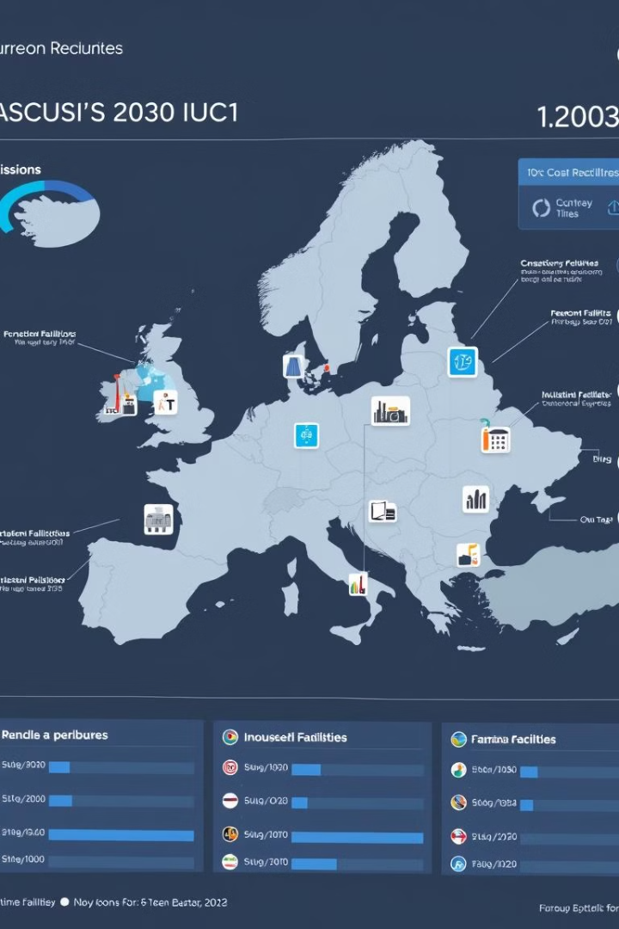
EU Industrial Emissions Portal Regulation (IEPR)
The IEPR establishes the Industrial Emissions Portal, providing public access to valuable environmental data related to industrial installations across the EU.
1
Transparency
The portal promotes transparency and public access to environmental information, enabling informed decision-making and engagement.
2
Data Access
Citizens can view emissions data from industrial installations and permits issued in the EU, enhancing environmental accountability.
3
Streamlined Reporting
The portal streamlines reporting processes, improving the monitoring and management of emissions across the industrial landscape.

Slide 5




China's New Data Regulation on Cross-Border Data Flows
China's updated data regulation on cross-border data flows aims to simplify the process for multinational corporations, easing the regulatory burden on data transfers.
Thresholds
Exemptions
Simplified Applications
The regulation raises thresholds for triggering governmental approvals for cross-border data transfers, streamlining the process for businesses.
Specific scenarios such as contract performance and HR management now benefit from exemptions, reducing regulatory complexities for MNCs.
The application process for security assessments and contractual compliance has been simplified, facilitating smoother data transfer procedures.

Slide 6

Implications for Industrial Data Management
The new regulations highlight the evolving landscape of industrial data governance, emphasizing the importance of sustainability, transparency, and security.
Sustainability
Data centres are encouraged to monitor and report environmental performance, promoting a responsible industry.
Transparency
The IEPR provides public access to environmental data, promoting transparency and public engagement.
Security
China's updated regulation simplifies data transfer procedures for MNCs while maintaining strong legal foundations for data protection and security compliance.

Slide 7

Adapting to the Changing Landscape
It's essential for industrial businesses to adapt to these regulatory changes, ensuring their practices align with the evolving landscape of data governance.
Compliance
Businesses need to prioritize compliance with these regulations, ensuring they meet the specific requirements for data management, security, and reporting.
Technology
Investing in technology solutions that support data security, privacy, and sustainability is crucial for navigating the evolving regulatory landscape.
Collaboration
Collaboration with industry stakeholders, regulatory bodies, and technology providers is essential for effective adaptation and compliance with new regulations.

Slide 8





The Future of Industrial Data
As technology continues to advance, the industrial data landscape will continue to evolve. It's essential to stay informed and adapt to these changes to ensure businesses remain competitive and sustainable in the future.
Data Security
Data security will remain a paramount concern, with continuous innovation in cybersecurity measures.
Sustainability
Sustainability will become increasingly integrated into data management practices, minimizing environmental impact.
Transparency
Transparency in data handling and reporting will continue to be a key driver for trust and accountability.
Cloud Adoption
Cloud computing will continue to gain traction, offering scalable and flexible solutions for data storage and management.

